Slide 1

Efficient Continual Learning with Latent Rehearsal
Gabriele Graffieti, Lorenzo Pellegrini, Vincenzo Lomonaco, Davide Maltoni
University of Bologna
{gabriele.graffieti; l.pellegrini; vincenzo.lomonaco; davide.maltoni}@unibo.it

Slide 2


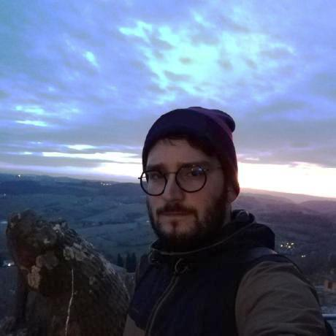

Unibo Team
Davide Maltoni
Vincenzo Lomonaco
Gabriele Graffieti
Lorenzo Pellegrini

Slide 3
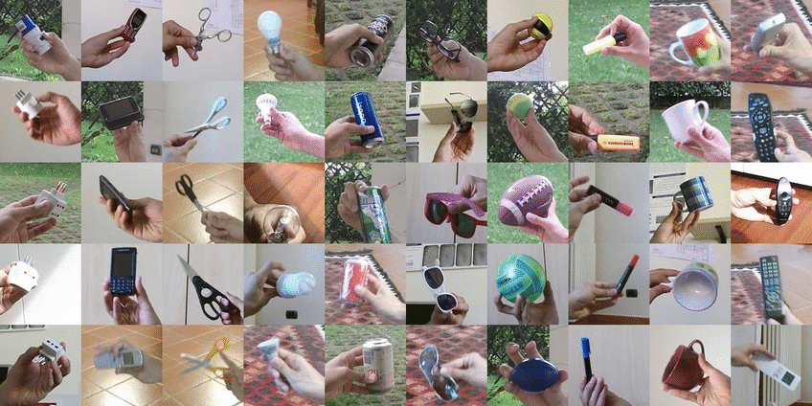

CORe50
CL Scenarios:
NI
NC
NIC

Slide 4
IROS Lifelong Object Recognition Challenge
NI strategy
LwF is a good and lightweight approach in this scenario
Rehearsal
Even a simple strategy is effective
Main drawbacks: more memory and computation required

Slide 5
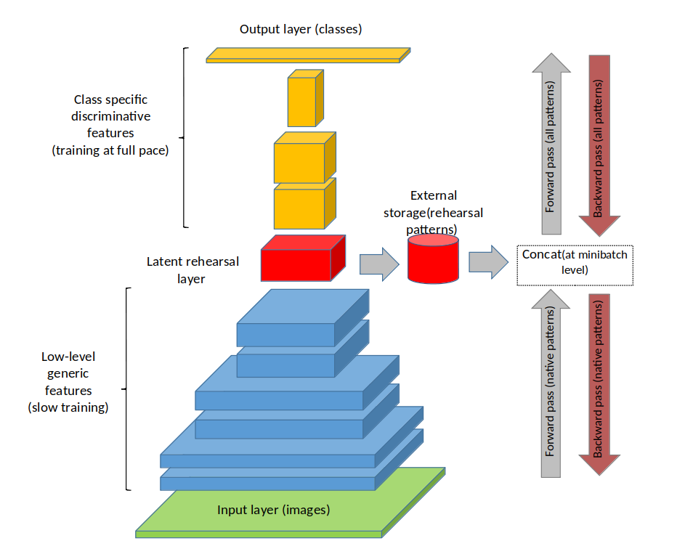
Latent Rehearsal

Slide 6
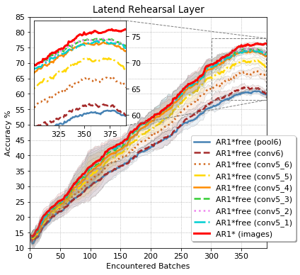
Latent Rehearsal

Slide 7
Competition Strategy
LwF + Rehearsal (from the input layer)
Higher accuracy
Training time not evaluated
Preprocessing
Images rescaled to 224x396
The center crop (224x300) is taken
Random 224x224 crop is used for training

Slide 8
Results
 | Cumulative | LwF | Input rehea. | latent rehea.
Accuracy | 97.14% | 93.72% | 97.48% | 90.57%
Model size | 9.1MB | 5.7MB | 5.7MB | 5.7MB
Rehearsal Memory size | 0 | 0 | 150MB | 7.8MB
Inf. time | ~1m47s | ~1m35s | ~1m32s | ~1m33s

Slide 9
Conclusions
Latent rehearsal can be effectively used to train a CL model directly on mobile devices.
The strategy can be tuned in order to increase accuracy or training speed.
First real time training on smartphones (to be released)

Slide 10
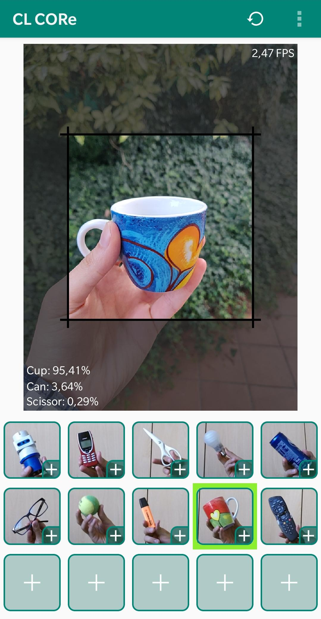
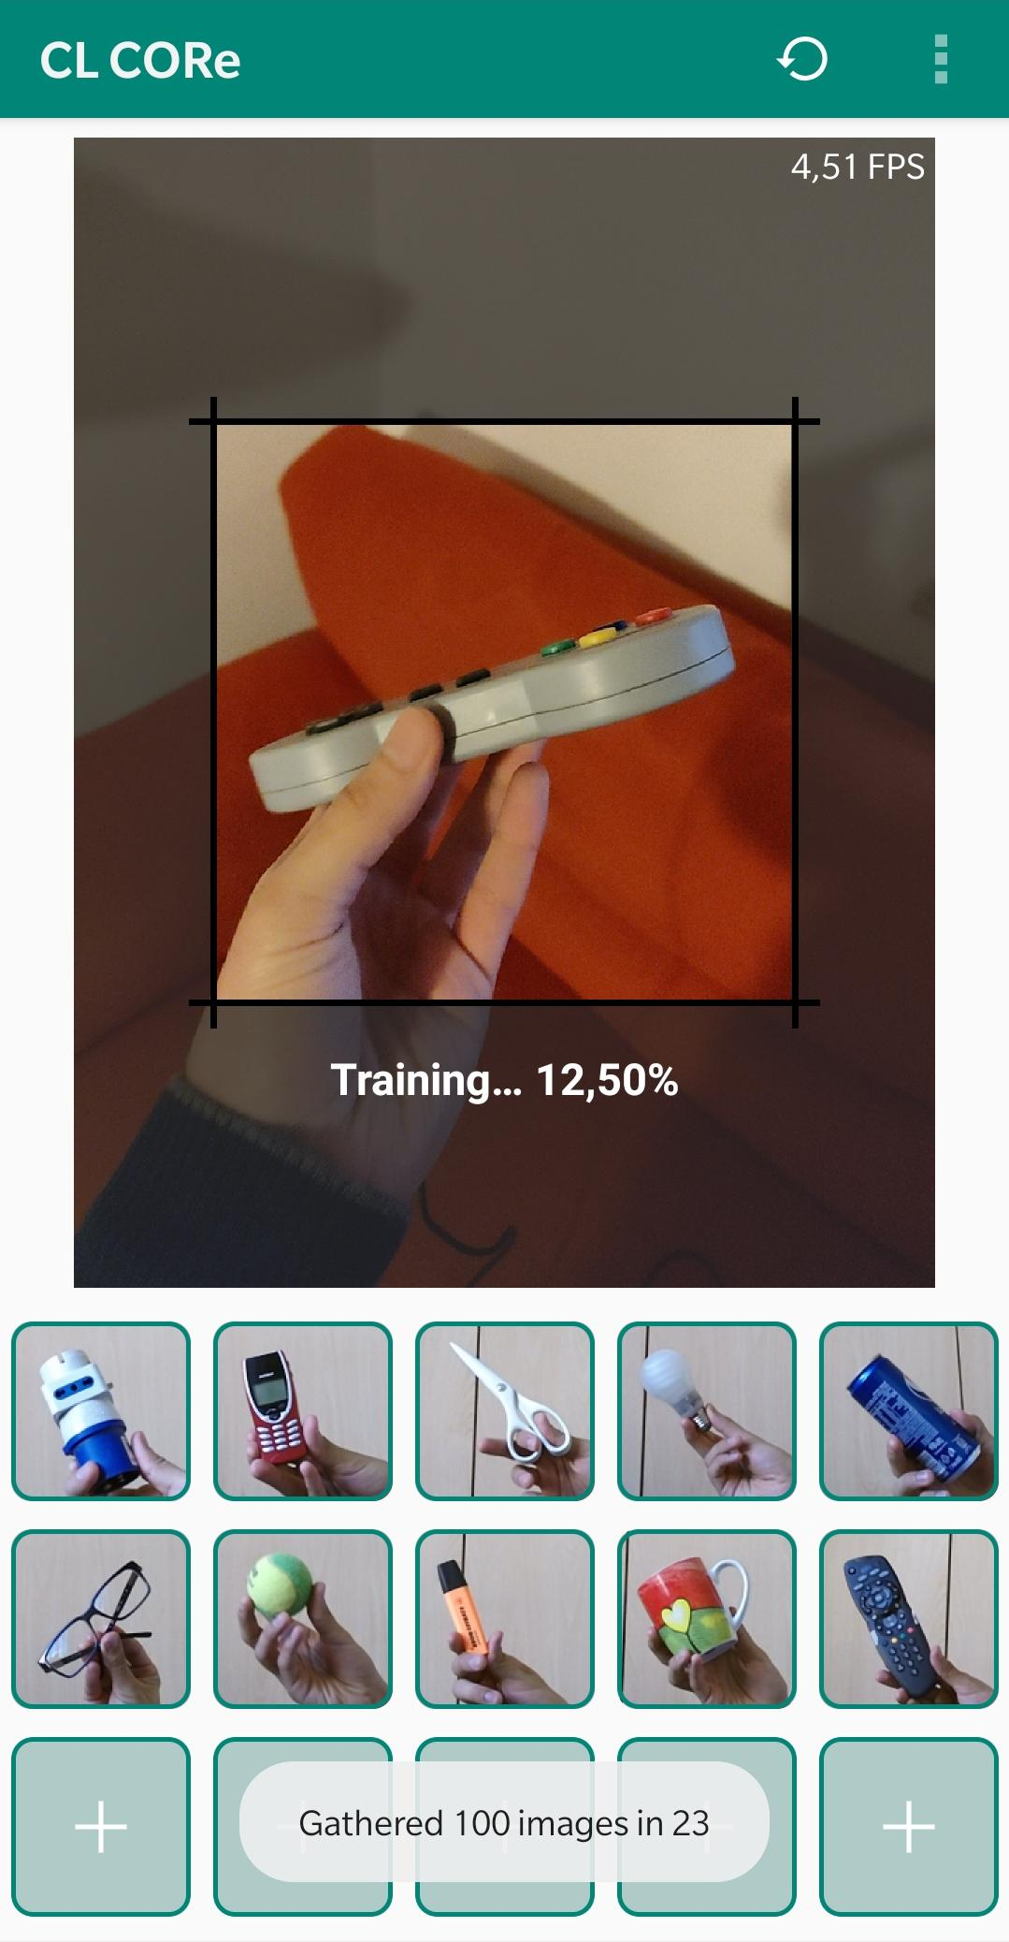
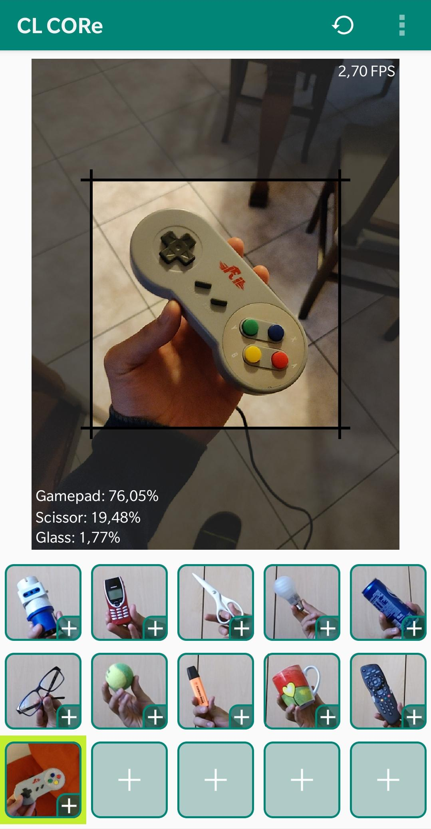
Training on mobile

Slide 11
Thank you!

